Slide 1
Project Butterﬂy: Synergizing Immersive Virtual Reality with Actuated Soft Exosuit for Upper-Extremity Rehabilitation
IEEE VR 2019

Slide 2
Introduction
1. Older adults (deﬁned as people aged 65 years old or older) living in the US comprise 13 percent of the US population.
2. In addition to the decline in motor function, aging correlates to the progressive loss of skeletal muscle mass and strength.
3. Drawbacks of traditional method derived from therapists’ observation and judgment are that they are often inaccurate, expensive, and timely.
4. Virtual reality is a useful tool for improving outcomes compared to conventional therapy by enabling accurate motion capture, telepresence based sessions, and low cost motivating experiences.

Slide 3
Introduction
5. Through combining VR with exoskeletons that provide arm gravity support, clinical testing showed a range in improvement of mobility, strength, and satisfaction.
6. This study aims to leverage such soft exosuits during VR therapy through the use of Compliant Robotic Upper-Extremity Exosuit(CRUX) to explore feasibility, ease-of-use, and comfort.

Slide 4
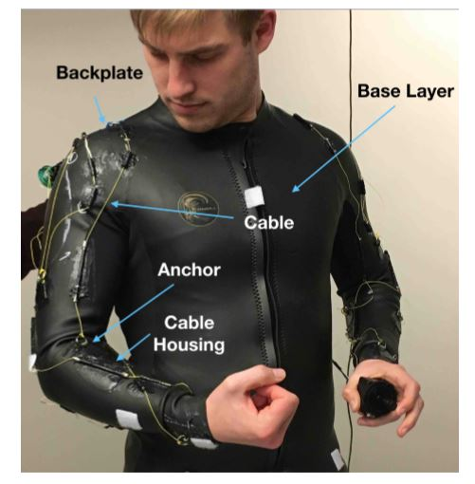
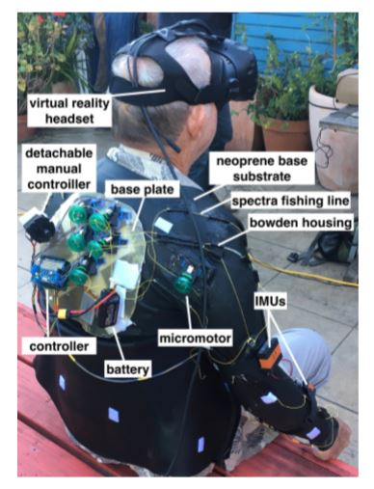

Slide 5
System Design
1. Project Butterfly (PBF), is a game that motivates users to perform upper body motion primitives by having them protect a virtual butterfly in a meadow while the system collects real-time data using the HTC Vive.
2. These mechanics required the users to smoothly follow the flight of the butterfly within +/- 0.1m of the required motion path.
3. To generate the environment and the mechanics of PBF, the Unity v2017.1.0b4 Game Engine along with the SteamVR Unity plugin v1.2.0 became the chosen development tools.
4. To enable the mimetic control of the healthy arm onto the weak limb, wireless connectivity capability was added to connect with the Inertial Measurement Unit (IMU) networks.

Slide 6
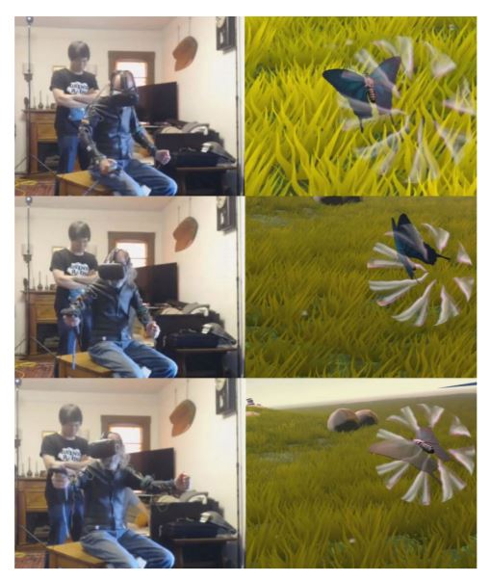

Slide 7
Usability Study
1. Participants
(1) Three retirees from Elderday Adult Day Health Care Center, Santa Cruz, CA, represented a mental disability.
(2) Three stroke survivors recruited from Cabrillo College’s Stroke and Disability Learning Center (SDLC), Capitola, CA, represented a physical disability.
(3) Three retirees living independently within their community, outside of daycare or hospice, which do not have a significant physical or mental disability.
(4) All participants ranged between the ages of 60 to 80 years old and were previously unfamiliar with both virtual reality and wearable robotics.

Slide 8
Usability Study
2. Procedure
(1) For each user, the evaluation began by an proctor giving a detailed explanation of what PBF and CRUX are, answering questions as needed.
(2) Then the user was given a tutorial consisted of playing two rounds of the biceps (二头肌) minigame and the lateral arm (侧腕) minigame for one minute each.
(3) After the tutorial period, the test commenced with the user playing game while wearing the CRUX exosuit.
(4) User evaluation interviews were executed by asking users questions pertained to their experience from a prepared form with questions.

Slide 9
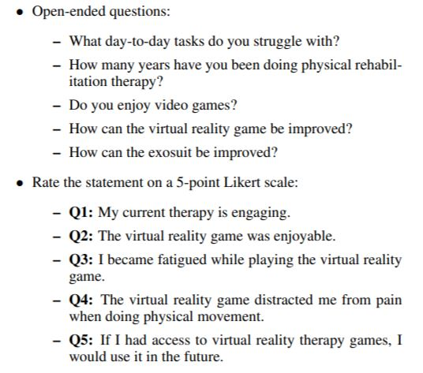

Slide 10
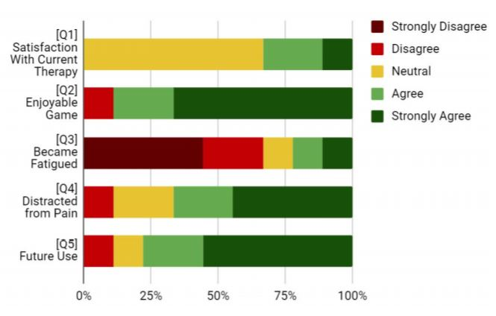
Results and Discussion
1. Most participants felt that CRUX augmented their upper limb movements to some degree.

Slide 11
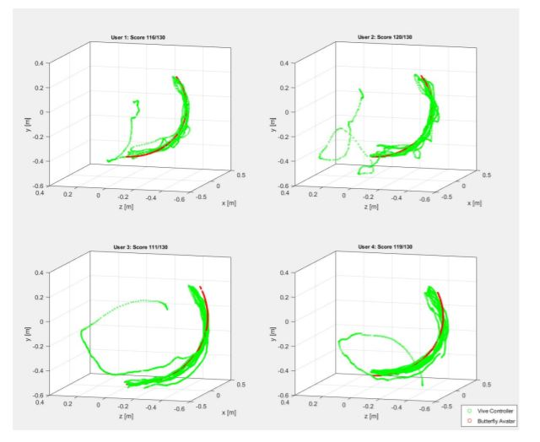
Results and Discussion
2. User 1 had sharp changes, User 2 had shaky movements, User 3 had smooth moves, and User 4 had smooth and shaky movements.

Slide 12
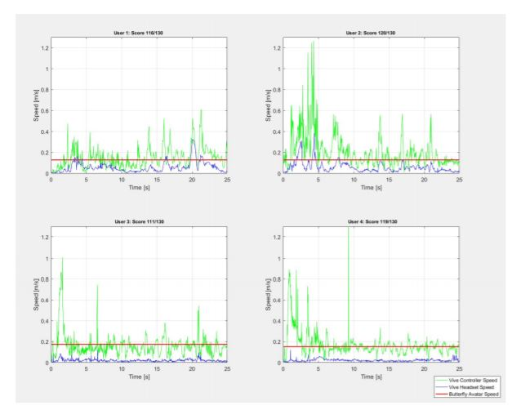
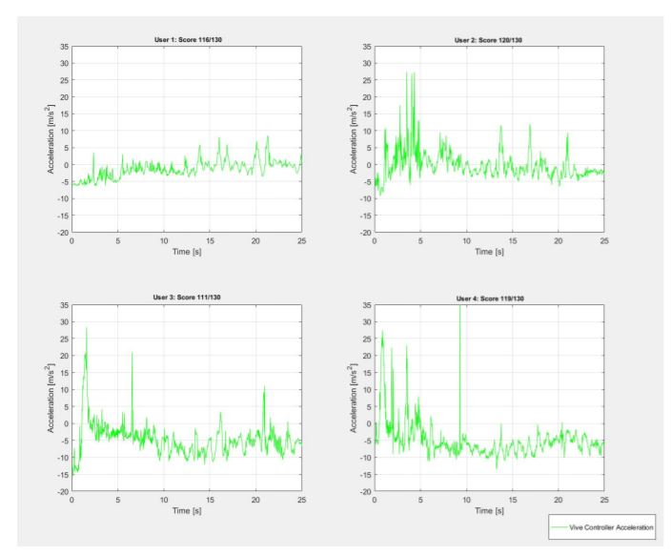
Results and Discussion
3. User 1 maintains the most control nearing almost no acceleration, followed by User 2 who spikes but nears zero, and Users 3 and 4 experienced occasional large shaking.

Slide 13
Limitation
1. One user thought that continuously protecting a butterfly would become boring for regular therapy.
2. Neoprene (氯丁橡胶) made CRUX hot when worn over an extended period.
3. Only three motion primitives were explored and converted into VR through PBF (lateral shoulder raise, forward arm raise, and horizontal shoulder rotation).
4. Furthermore, this study would benefit from a larger sample size of the users.

Slide 14
Conclusion
1. The system’s ease-of-use and comfort were analyzed, and most users felt that they were confident capitalizing on the therapy system.
2. An immersive physio-therapy VR game with an actuated soft robotic exosuit had promising results in the potential future of a more accessible, affordable, and personalized rehabilitation.

